Slide 1

Phishing Attack Simulation Using Zphisher Tool

Slide 2

Phishing
Phishing is a social engineering
cyber attack where attackers' trick users into revealing sensitive
information by impersonating
legitimate websites or services. It
relies on human trust rather than
technical vulnerabilities, often using
fake login page

Slide 3

Threat
Phishing works because it exploits
human psychology—people tend to trust
familiar logos, urgent messages, and
official-looking emails or websites.
Attackers take advantage of this trust to
deceive users into voluntarily giving up
sensitive information like passwords or
financial details.

Slide 4
Real-World Implications
● Email Phishing
● Smishing (SMS phishing)
● Vishing (Voice Phishing)
● Website Spoofing
● Whaling: a targeted phishing attack that focuses on
high profile indivicuals such as CEOs or CFOs

Slide 5
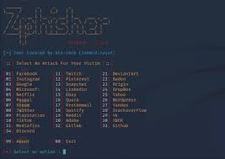
Technical Overview Tools & Environment
● Kali Linux VM: used for a secure, isolated
testing environment
● Zphisher: A user-friendly, open-source
phishing tool that simplifies phishing
attacks by offering ready-made templates
for over 30 popular sites like Facebook,
Google, and Instagram. It’s easier to use
than the Social-Engineer Toolkit and can
also support custom templates. Zphisher
is commonly used to simulate phishing in
wide area networks and capture
credentials like usernames and passwords.

Slide 6
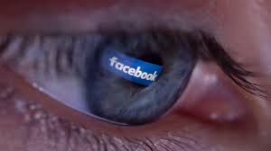
Technical Overview
Defensive context / red team use
Security professionals and students
use zphisher in penetration testing
simulations to:
○ Train on sical engineerintg
tactics
○ Understand how phishing
campaigns work
○ Develop adn test email
filters, browser
protections, and
awareness training
D
1. Tool set up
2. Server and link creation
3. Lure the target
4. Victim interation
5. Credential harvesting
6. Attacker access

Slide 7

Research steps
Studied phishing attacks
and how attackers mimic
trusted interfaces to steal credentials
Ensured ethical compliance
by
conducting all testing locally
with no real user

Slide 8
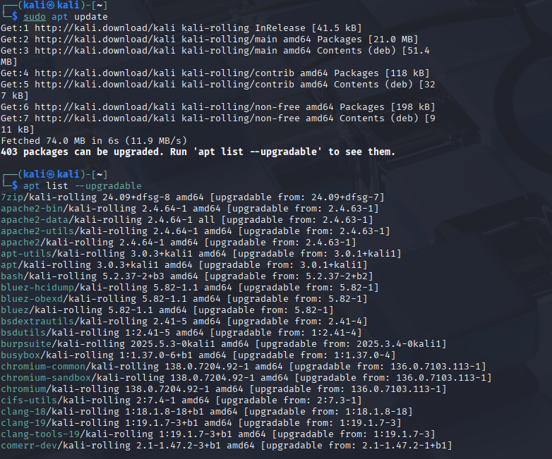
Demonstration Overview

Slide 10
Results & Summary
Objective: To simulate
a phishing attack by
cloning a legitimate
login page and
capturing credentials
using the Zphisher tool
Captured data:
○ Username
○ Password
○ IP address
○ User-agent info (browser,
OS, device details)

Slide 11
Key takeaways
● Phishing pages generated by Zphisher are visually
convincing and closely mimic real login pages.
● A user with low awareness or without security
protections could be tricked into giving up
credentials.
● Tools like Zphisher demonstrate how easily social
engineering can bypass technical defenses.

Slide 12

Mitigation strategies
User Education & awareness
○ Train users to recognize
phishing attempts (e.g.,
suspicious URLs, fake login
pages, unexpected requests).
● Multi-Factor Authentication (MFA)
○ Enforce MFA on smart devices
and user accounts wherever
supported.
Device Firmware & Software Updates
○ Keep smart camera firmware up
to date to patch vulnerabilities
that could make phishing easier
(like outdated login portals).
● Segmentation of IoT Devices
○ Place smart devices like
cameras on separate network
segments (e.g., guest Wi-Fi) so
attackers can’t easily pivot into
critical systems if
compromised.

Slide 13

Ethical Reminder
This project is a controlled simulation
for educational purposes only. Never
perform phishing attacks on real users,
networks, or devices without explicit
permission. Ethical hacking must
always follow legal guidelines and aim
to protect, not exploit.

Slide 14

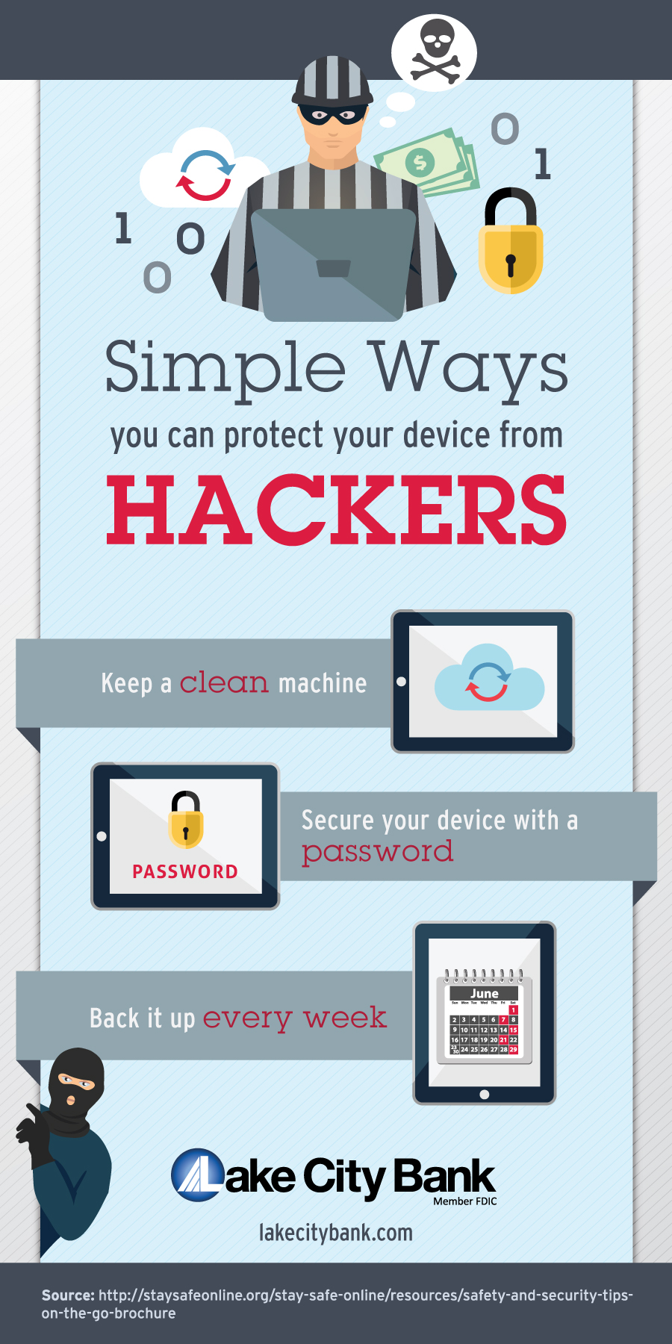
Thank you

